Slide 1
Real-Time Automatic Checkout System Using Object Detection Models:
Streamlining the Shopping Experience with AI
GitHub Link:
Joon Park

Slide 2
Object Detection Increase Efficiency within Grocery Stores
Current Problem
Model Benefits
Implementing a real-time automatic checkout system aims to address these issues by reducing wait times, enhancing customer satisfaction, and optimizing store operations through the use of state of the art object detection models such as Yolov5.
Traditional checkout process in grocery stores is often time-consuming and labor-intensive leading to longer queues, customer dissatisfaction, and increased operational costs.

Slide 3
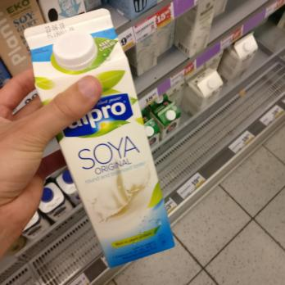
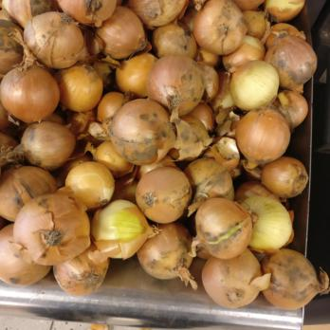
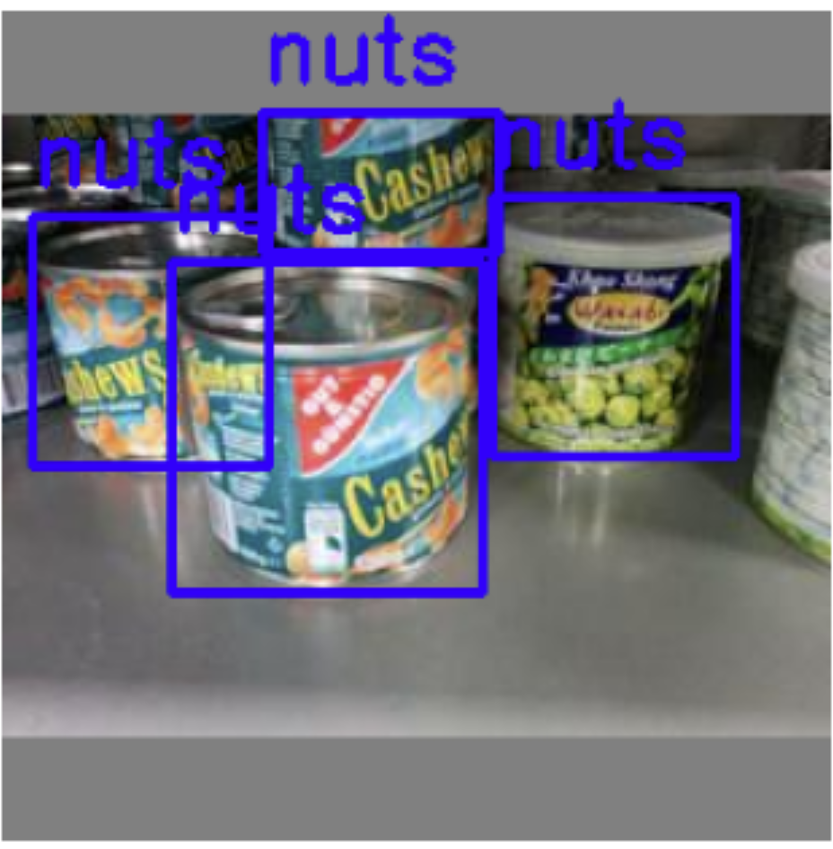
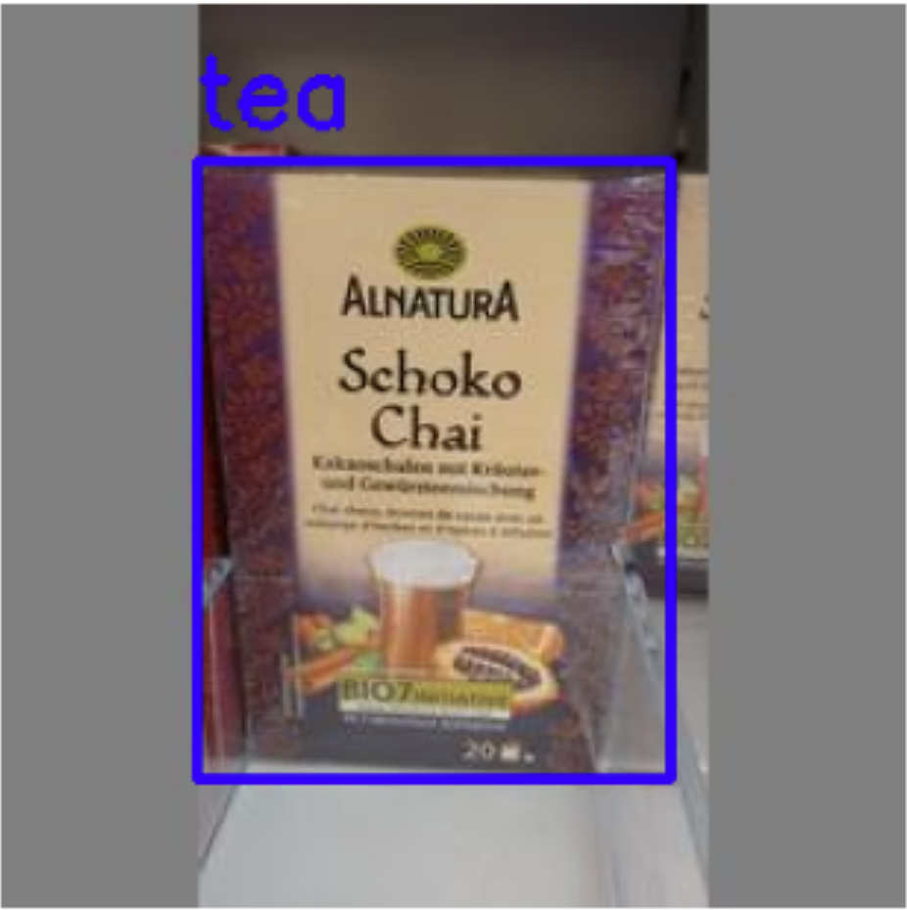
The Freiburg Grocery is Suitable to Create the Checkout System
The Freiburg Grocery Store Dataset¹ is a comprehensive collection of grocery store item images specifically designed for training and evaluating various different computer vision models.
There are 25 different grocery item categories ranging from fruits, vegetables, beverages, candies, and other packaged goods.
The dataset contains roughly 5000 high resolution images captured in a real grocery store environment.
These images are in diverse lighting conditions and backgrounds
In order to prepare the dataset for the various object detection model, Roboflow’s labeling tool was utilized to label and create the bounding boxes for each image.
Sample Images
Labeled Images
¹ Jund, P., Abdo, N., Eitel, A., & Burgard, W. (2016). The Freiburg Groceries Dataset. ArXiv. /abs/1611.05799

Slide 4



Hypotheses About the Data and Model
Having a proper dataset which includes a diverse and representative sample of items that the model will encounter in the real-world will enable the mode to generalize better to unseen data.
Using data augmentations in addition to the representative sample of data will enhance the model’s robustness to variations in different environmental conditions
It is just as important to not only focus on the evaluation metrics such as precision and recall but also the inferencing speed. Different model architectures will have different tradeoffs in terms of both of these criteria.

Slide 5
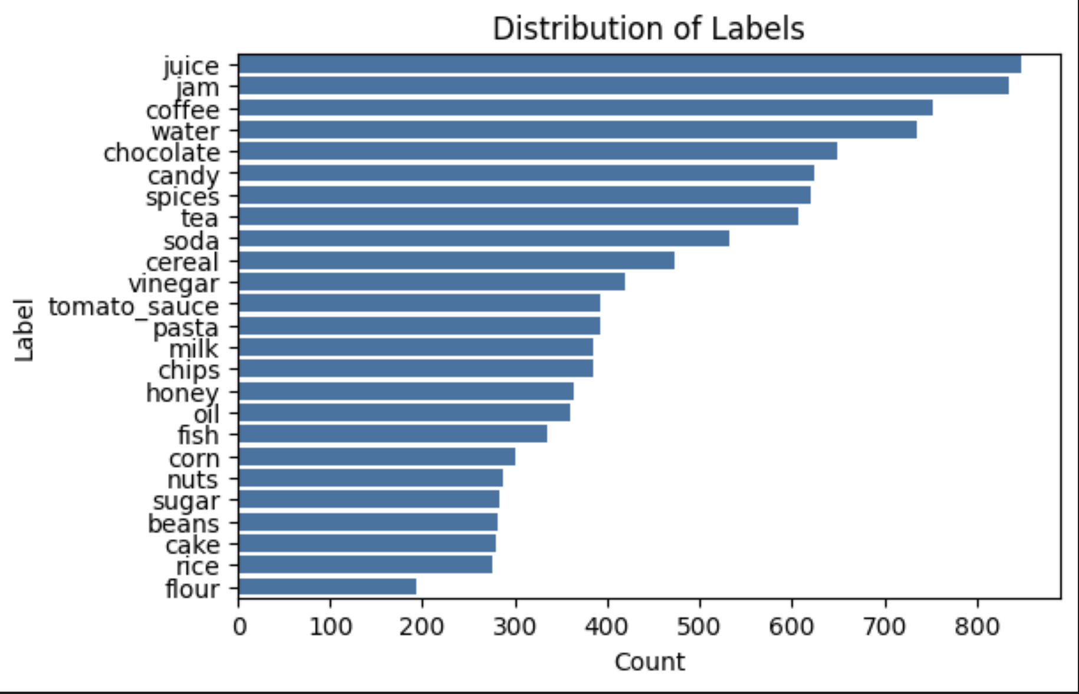
There are clear signs of class imbalance within the dataset
The graph on the right shows that there are unequal number of labels for each item.
If the class imbalance is left unchecked, the model will not be able to generalize well on new data and create a biased model that is overfit to the majority class. Therefore, it is crucial that models tackle this problem.
The models that will be mentioned later in the presentation all have methodologies that tackle class imbalance through techniques such as focal loss, different data augmentation techniques, and oversampling

Slide 6
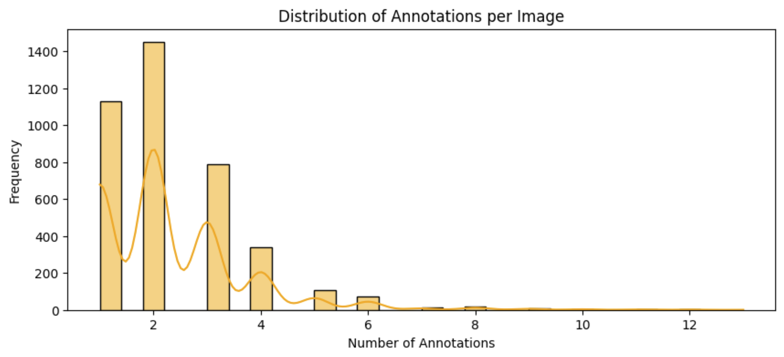
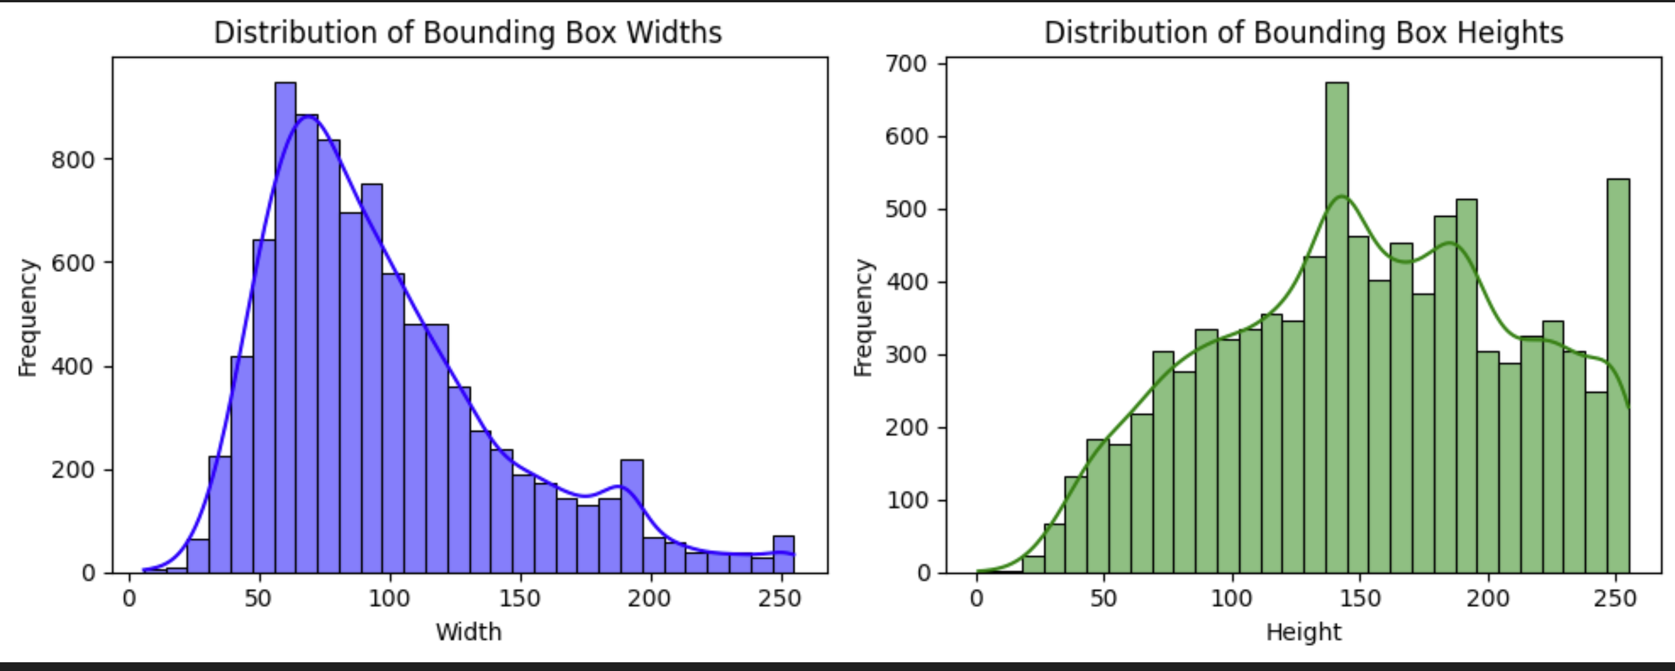
Annotation and Bounding Box Distributions Provide Key Insights
Annotation Density: Represents the number of bounding boxes per image in the dataset. Knowing the density provides insights about several topics such as:
Dataset Complexity – High Annotation density indicates image with many objects with can be more complex for models to learn
Bounding Box Size Distribution: Shows the height and weight distributions of bounding boxes in each image. This helps us with:
Resizing Strategies: If the dataset has a wide variety of bounding box sizes, knowing the distribution can help choose the right resizing strategy during data augmentation

Slide 7
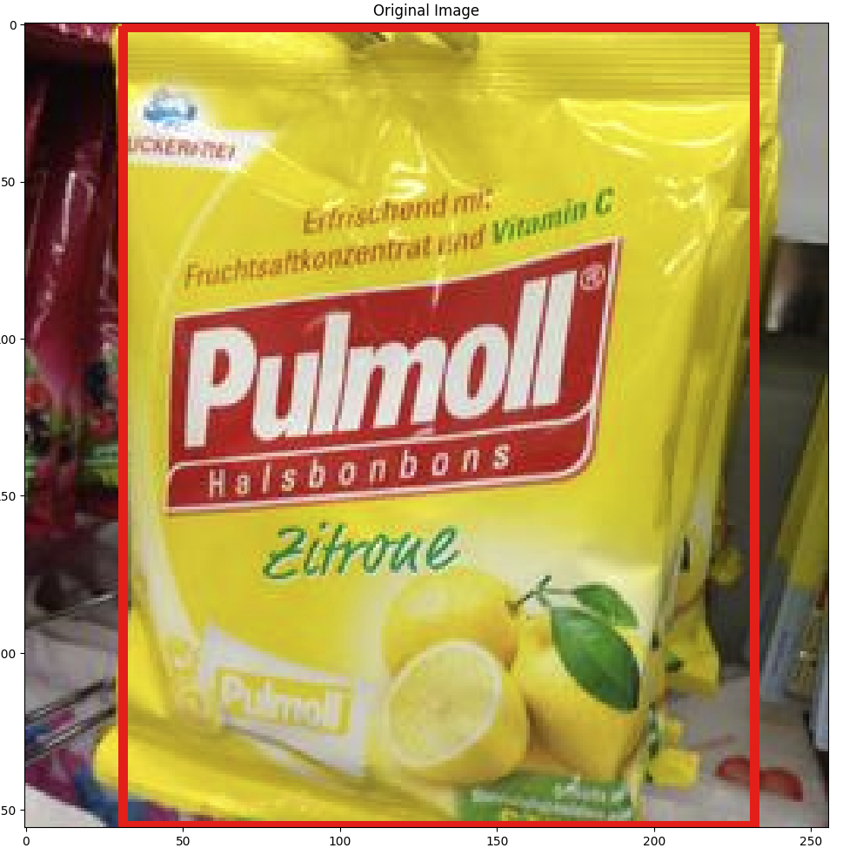
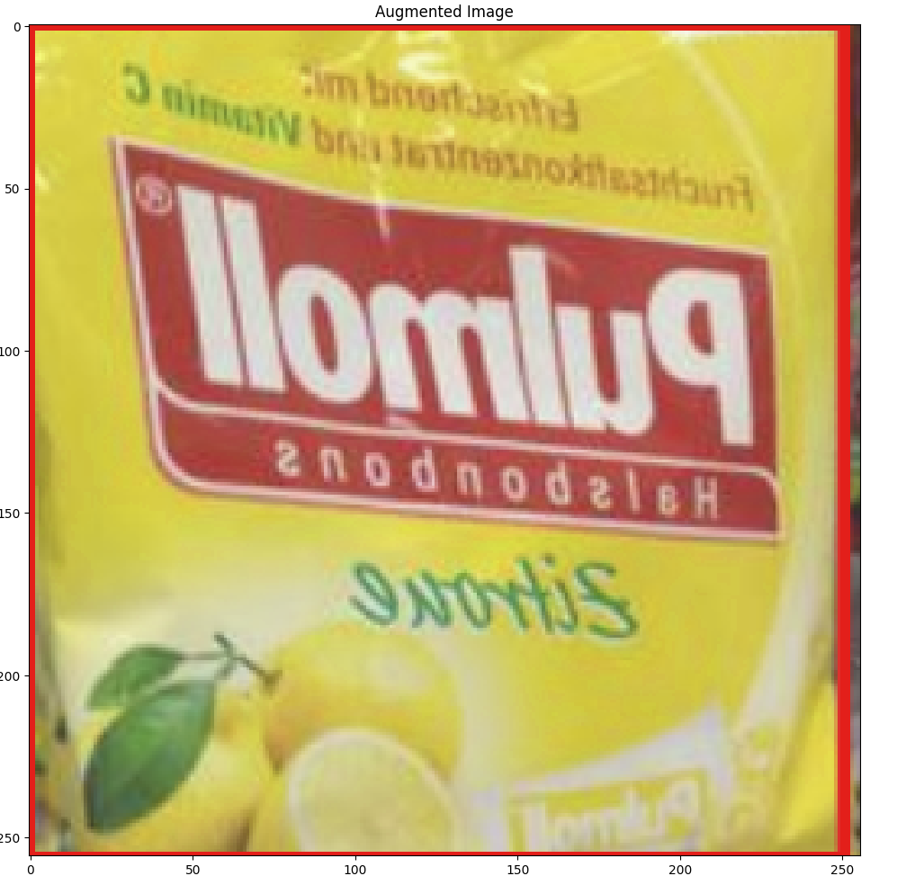
Proper Preprocessing and Data Augmentation Steps were Taken to Serve as Optimal Inputs for the Models
Preprocessing steps were performed to prepare the images and annotations for training, which ensures consistency and optimal inputs for the models. For example:
Up/Downscaling Images: Images (currently 256x 256) were upscaled with the hopes of making smaller objects more prominent and downscaled to increase computational efficiency.
In addition, data augmentation was applied to the images to help increase the diversity of the training dataset, which lead to better model generalization and help with class imbalance. Some augmentations include:
Color Changes: Modifying the hue, saturations, and brightness of images
Geometric Transformation: Translating and scaling images
Flipping: Randomly flipping images horizontally
Mosaic Augmentation: Combining four images into one for more diverse training samples
Original Image
Augmented Image
*Specific values of the augmentation parameters were experimented to help determine the best performing model.

Slide 8
Various Different Models were Experimented to Determine the Best Model
You Only Look Once version 5 (YOLOv5)
Single Shot MultiBox Detector
Faster R-CNN
Yolov5 is a single-stage detection which means that it predicts bounding boxes and its probabilities through a single pass through the network.
Pros:
Given the model’s architecture built on CSPDarknet, YOLO’s key strengths are primarily built on fast inferencing speed, its relative simplicity to understand the architecture, and low resource usage.
Cons:
While YOLOv5 is fast, it may not achieve the same level of accuracy as some of the other models especially when it comes to detecting smaller objects.
SSD is also a single-stage detection model built through popular classification backbones sch as VGG16.
Pros:
SSD uses feature maps from multiple layers of the network to detect objects which provides a more robust detection model to detect small and large objects simultaneously.
Cons:
Training an SSD can be more complex due to the need to balance multiple loss components.
Faster R-CNN is a two-stage detection model which first generats a set of candidate object regions in the first stage then refines these regions for classification.
Pros:
Faster R-CNN generally provides higher accuracy compared to the other models listed and is accept to be better at handling more challenging detection tasks.
Cons:
Faster R-CNN is comparatively slower than the other two models due to the two-stage process. The architecture is more complex and the model requires higher computational and memory requirements.
To monitor signals of overfitting, each model was trained on the same dataset and tracked the training and validation losses, employed strategies such as early stopping, and evaluated the performance on a testing set.

Slide 9
Several Criterions will be Observed to Determine the Best Model
To select the most suitable model, YOLOv5, SSD, and Faster R-CNN will be evaluated based on the following criteria:
Evaluation metrics: Measured by metrics such as mean Average Precision (mAP), precision and recall.
Speed: Inference time and latency.
Scalability: Ability to handle varying object sizes and occlusions.
Resource Efficiency: Computational and memory requirements.
To ensure that the model performs well on unseen data the following regularization techniques will be applied:
Data Augmentation: Applying the random augmentations mentioned in previous slides increase dataset diversity.
Dropout Layers: Dropout layers were added to each dropout layers in the model architecture to randomly drop neurons during training.
Weight Decay: Applied L2 regularization to penalize large weights.

Slide 10
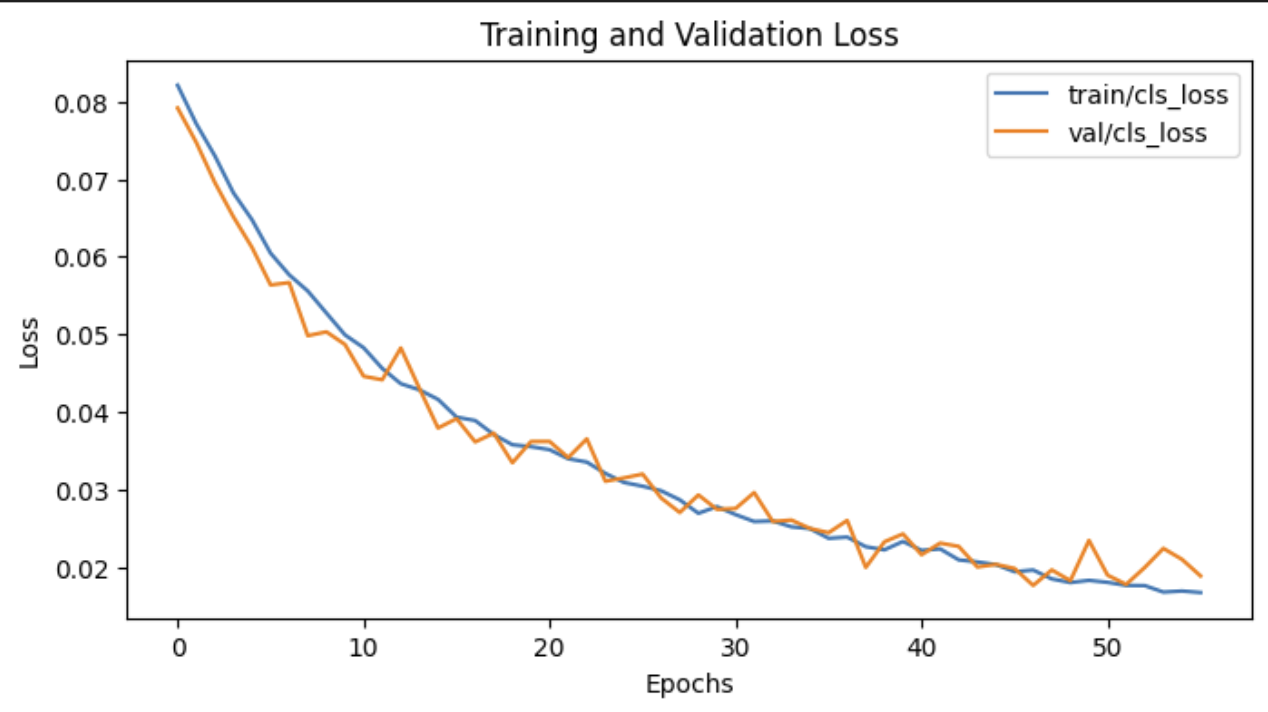
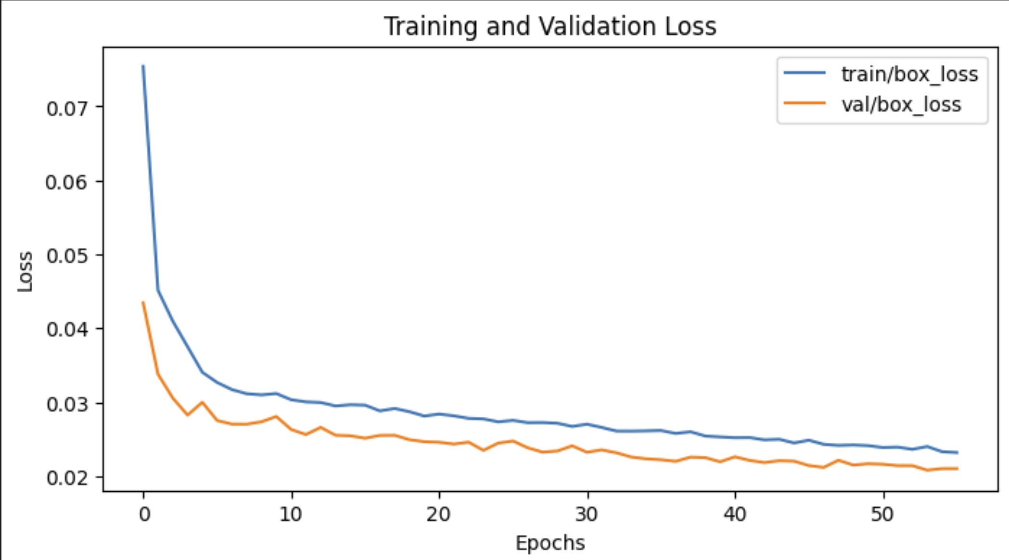
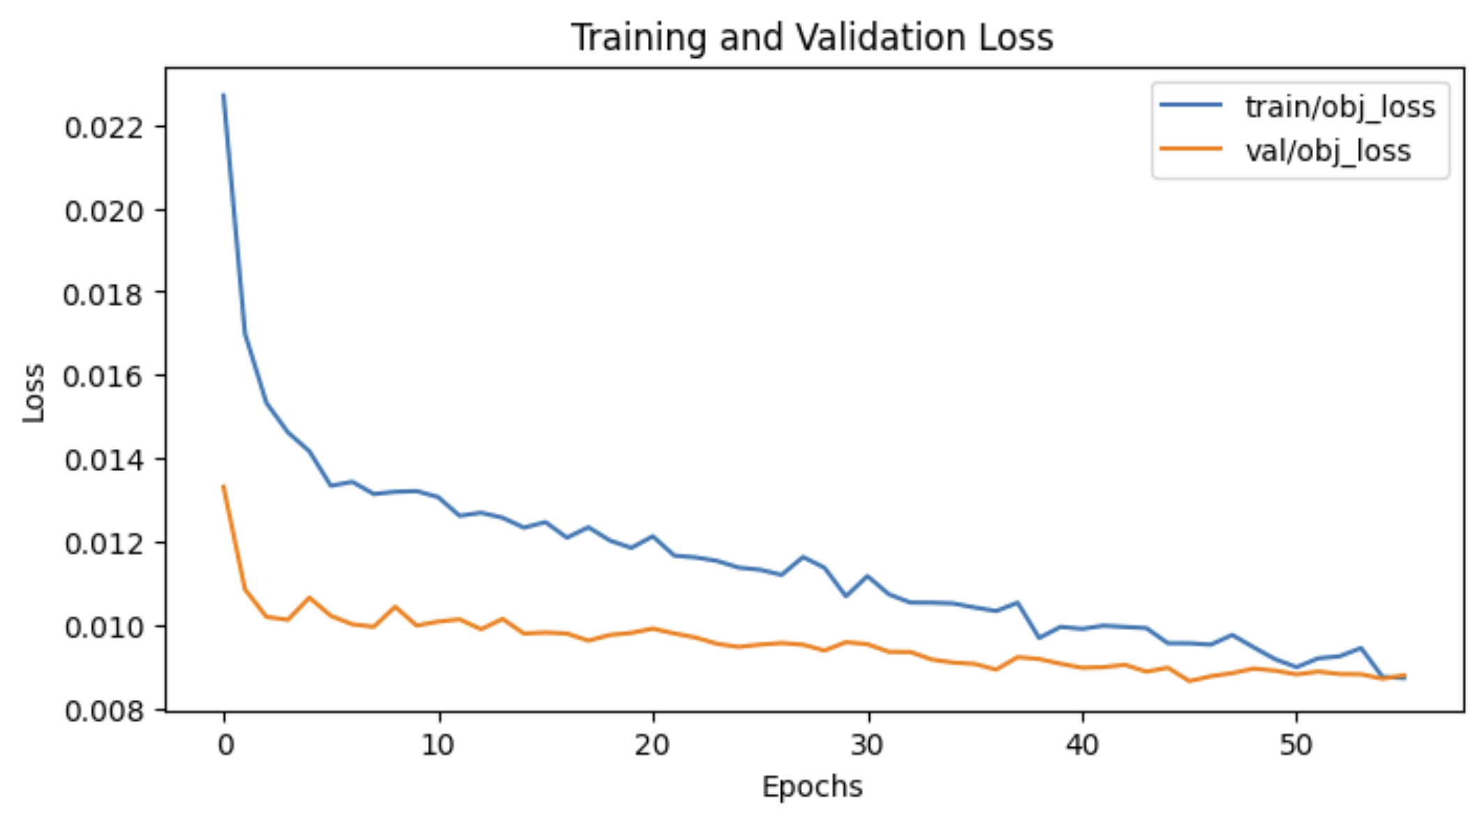
YOLOv5 Performed the Best Out of the Three Models
Based on the criteria on the previous slide, the best performing model was the YOLOv5 model. The following are the results of the model after 54 epochs.
Precision: 0.84
Recall: 0.77
mean average precision (intersection over union set to 0.5): 0.86
Not only did SSD and Faster-RCNN score marginally worse in the evaluation metrics but also took significant longer to train both the models
The three graphs below represent the training and validation losses for classification, box and object loss. When comparing the training and validation losses over the epochs, the losses were very consistent and did not diverge.
In addition, YOLOv5 also performed well on the testing set as well, achieving the following metrics of 0.84, 0.79, and 0.89 for Precision, Recall and mAP50, respectively.
Classification Loss
Box Loss
Object Loss

Slide 11
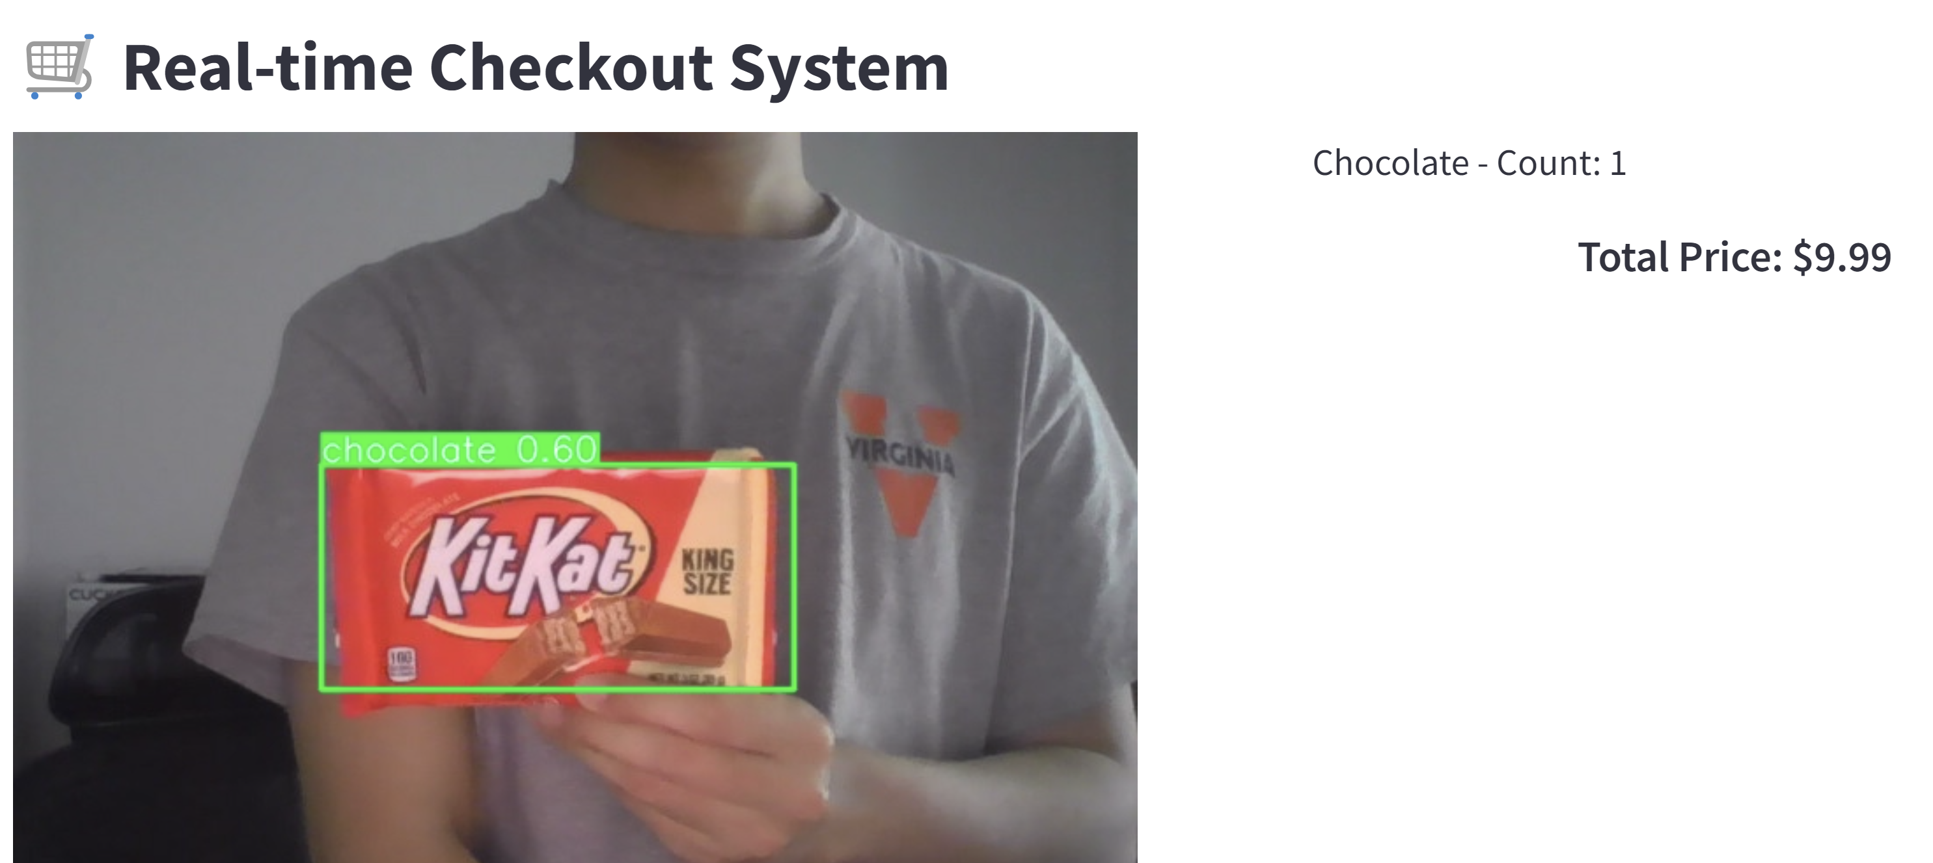
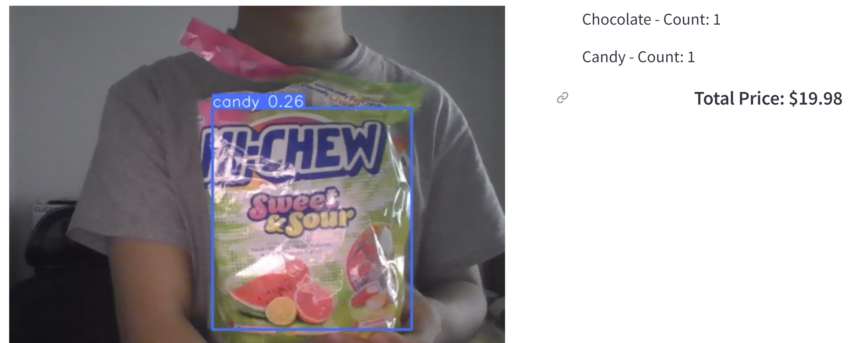
Model Underwent Additional Testing Through Real Products
In addition to evaluating on the given testing data, inference was run over a video of food items that was found in my own apartment to see how the model would perform in a more natural setting.
The model was able to detect the items very well when the product is facing directly at the camera as shown by the application on the right; However, when there is a slight change in the angles or different lightings, the model is not able to detect the items.
In addition to these faults, the model is able to identify products like candy, chocolate because the packaging is very diverse. However, the model had more difficult in detecting products like water, beans and pasta. This could be due to the similarity in shape and the labels across those products.
*Additional pictures of product test are included in the appendix

Slide 12
Developing a real-time checkout system involved significant technical challenges and considerations that provided valuable learnings.
Model Selection and Performance:
Models like YOLOv5, SSD, and Faster R-CNN offer different benefits and limitations in terms of inference speed, accuracy, and computational requirements. Understanding the trade-offs between these three factors is crucial for choosing a model that fits the business needs
Object detection (even those that are claimed as ‘light’) require significant computing power. Using a more powerful GPU and TPU allow for techniques such as model quantization, pruning, and hardware acceleration which allows for stronger models that improve inference speed.
Data Handling and Processing:
High quality annotated data is crucial for training accurate object detection models. Having a diverse dataset which represents real-world scenarios is crucial for the success of the object detection model.
Data Augmentation:
There was great difficulty finding the right combination of augmentation techniques that improve the models’ generalizability without degrading the mode performance.

Slide 13
Future Work
Advanced model architectures: Throughout this project, one of the biggest challenges was model selection. Given the time constraints and the computational resources, larger and more robust models were not able to be tested. In addition, models like YOLO and SSD are highly customizable and often include different variations of the same model used for different purposes. Therefore, in the future, more model architectures such as EfficientDet, YOLOv8, will be explored and implemented.
Experimenting with additional prediction methods: Some related works have noted the use of ensemble techniques for their system. Exploring different techniques such as ensemble methods and combining the strengths of multiple models could be helpful for improving accuracy and robustness.
Detecting specific items: The scope of the project was limited to classifying general grocery store item topics like beans, candy, chocolate. However, in order for this model to be more applicable, the model needs to be able to detect the specific brand of the grocery store items. This poses additional significant challenges. To tackle this, additional methodologies will be researched and explore novel detection techniques.
Extending Applications: The project could be adapted to be used in different retail environments such as clothing stores, electronics shops, and more.

Slide 14
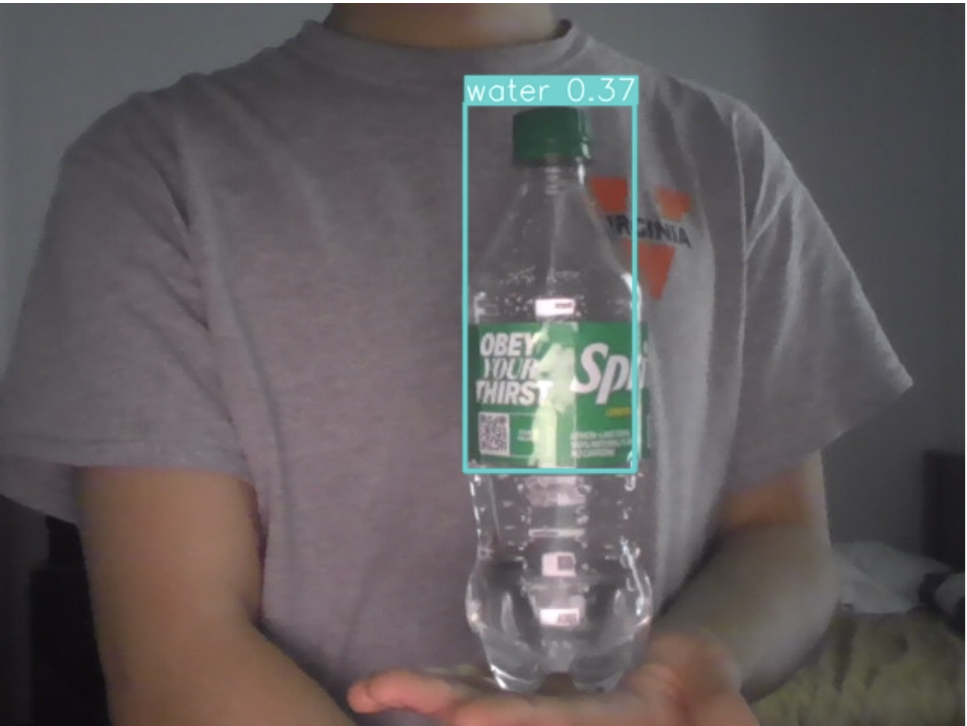
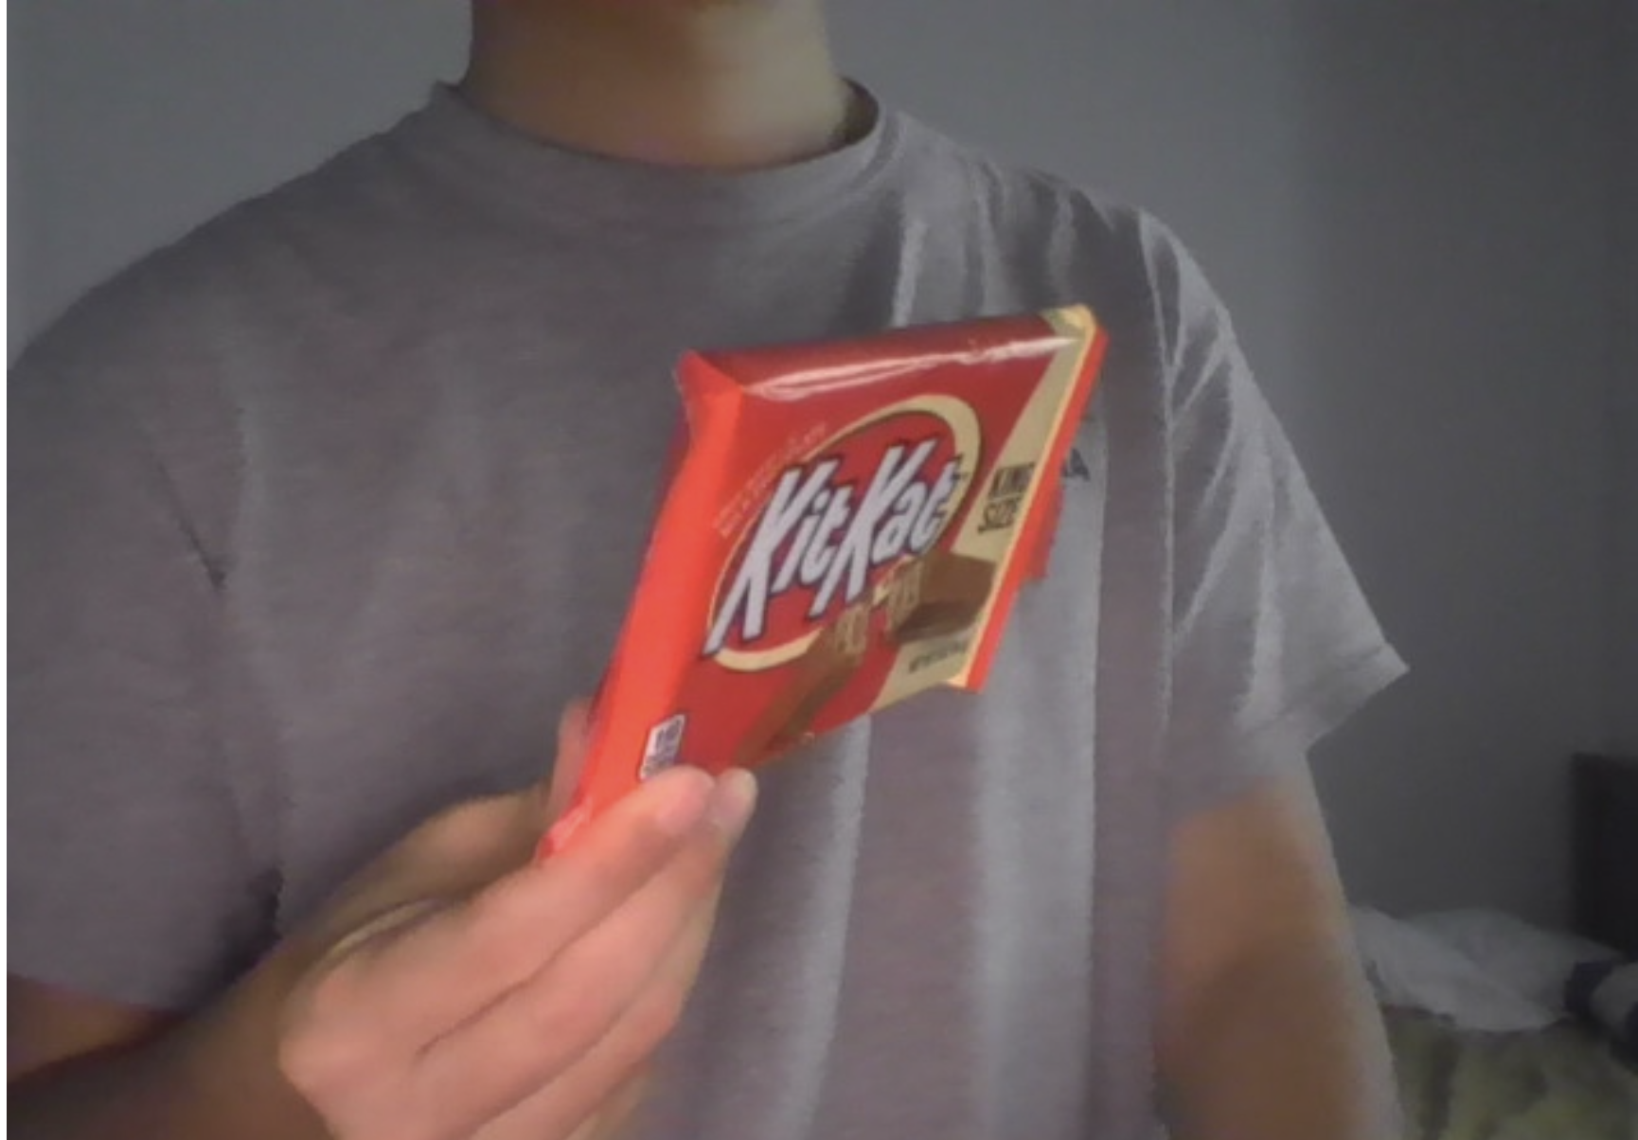
Appendix A: Variations of Detection Items
Figure A: Illustrates the common misclassifications . The top portion of the soda bottle is similar to water bottles trained on the dataset. Therefore the model is more confident about it as predicting as ‘water’ rather than ‘soda’
Figure B: Shows an example of how the model performances when the items is not directly facing the camera. The model is not able to detect the item.

